Slide 1
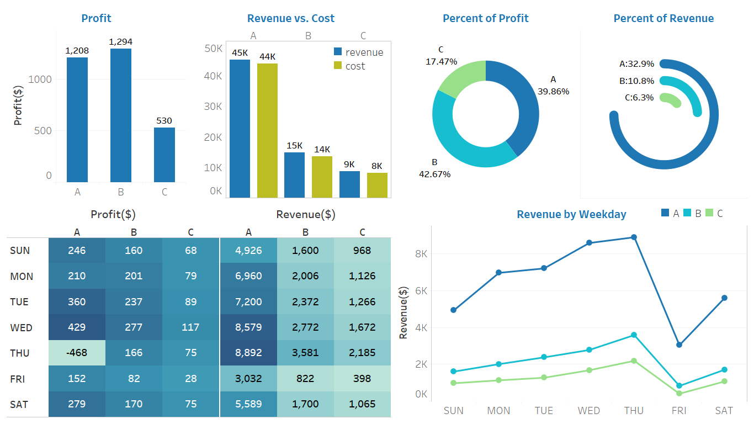

Slide 2
Bar chart - I used bar graphs to display the total profits and revenue in January, because they are relative easy to understand and show the low and high values in the data sets. It is also a very standard way to visualize things in many industries from my understanding.
(Radial) pie chart - To better interpret the product performance, showing the weights of the profit and revenue of each product is also important. I chose two types of pie charts (the default one and the radial pie chart) to make this performance report look more interesting.
Heat map - It is a great way to compare categories (aka, weekdays) using colors. We can immediately see from the graph that the higher profit (or revenue) of a day is displayed in a deeper color, while the lower profit (or revenue) is displayed in a lighter color.
Line chart - I made this 3-line comparison chart to show the revenue change by day of week, which can help readers to easily recognize the pattern - for all of the products (A, B and C), the revenue started increasing from Saturday, and Thursdays perform the best. However, the customers tend to spend less on Fridays as the revenue dropped significantly in the chart.

